Slide 2
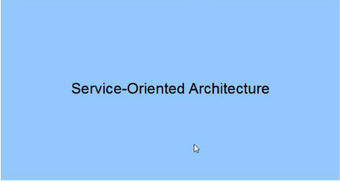
Unit –IV

Slide 3
Pre-requisite Concepts
Distributed Computing
- Distributed computing is a field of computer science that
studies distributed systems.
A distributed system is a software system in which
components located networked computers communicate and
coordinate their actions by passing messages.
The components interact with each other in order to achieve a
common goal.
Popular Example is Service Oriented Architecture (SOA)

Slide 4
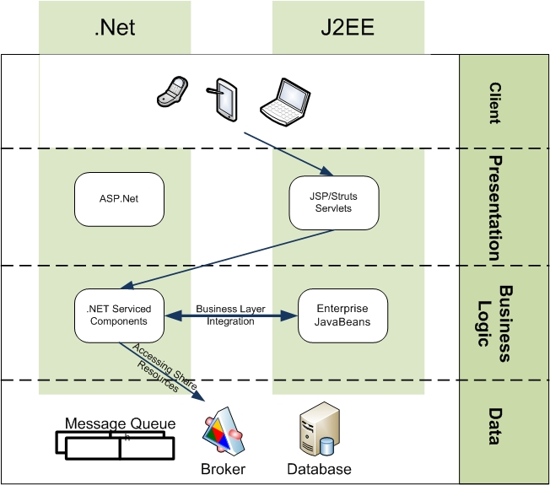
Pre-requisite Concepts
Interoperability
- Interoperability is the ability of diverse systems and
organizations to work together (inter-operate).

Slide 5
Pre-requisite Concepts
Serialization
Process of translating data structures or object state into a
format that can be stored (for example, in a file or memory
buffer, or transmitted across a network connection link) and
resurrected later in the same or another computer environment
This process of serializing an object is also called deflating or
marshalling an object. The opposite operation, extracting a data
structure from a series of bytes, is de=serialization (which is
also called inflating or unmarshalling).

Slide 6
Pre-requisite Concepts
Serialization (cont…)
String stud_name= “Vihar”;
Int sem=5;
Serialization
<xml >
…
<a:stud_name>Vihar </a:stud_name>
<a:sem>5</a:sem>
….
</xml>
De-Serialization
String stud_name= “Vihar”;
Int sem=5;

Slide 7
Loosely coupled and tightly coupled
Tightly Coupled
-
Loosely Coupled
-

Slide 8
We will learn
- SOA (meaning and need )
- SOA and WCF
What is SOA?
Vague
Misunderstood
For Example

Slide 9
Old Methods
Procedural like c
- Problems
OOP
- Problems
Solution:

Slide 10
What is Service?
Kitchen -> Waiter
Logical encapsulation of self contained business functionality.

Slide 11
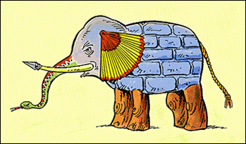
The man touching the trunk believes it to be a snake
The man touching the tusk believes it to be a spear
The man touching the ear believes it to be a fan
The man touching the elephant’s side believes it to be a wall
The man touching the tail believes it to be a rope
The man touching the legs believes they are trees.

Slide 12
SOA
As per W3C service oriented architecture is a set of components which can be invoked and whose interface descriptions can be discovered and published.
A loosely-coupled architecture designed to meet the business needs of the organization.
Base for Interoperability.
Separates functions in different independent units

Slide 13
SOA
Following key characteristics:
SOA services have self-describing interfaces in platform-independent XML documents. Web Services Description Language (WSDL) is the standard used to describe the services.
SOA services communicate with messages formally defined via XML Schema (also called XSD).
SOA services are maintained in the enterprise by a registry that acts as a directory listing. Applications can look up the services in the registry and invoke the service. Universal Description, Definition, and Integration (UDDI) is the standard used for service registry.

Slide 14
SOA
Data is passed through messages
XML and JSON(JavaScript Object Notation) are used for message passing.
Currently used in SaaS, Clould Computing etc.
Does not provide API but provides endpoint for connection.
For More Technical details visit:
http://msdn.microsoft.com/en-us/library/bb833022.aspx

Slide 15
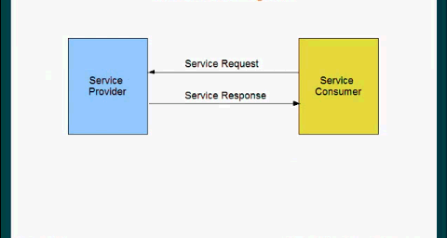
Service Oriented Architecture

Slide 16
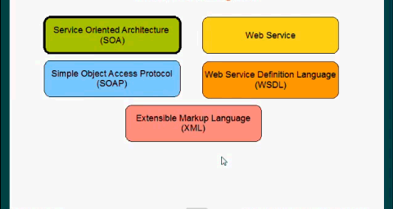
Terminology

Slide 17
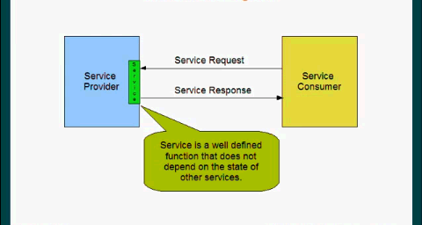
Service

Slide 18
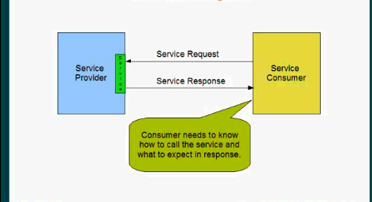
Consumer

Slide 19

SOA

Slide 20

Web Service

Slide 21
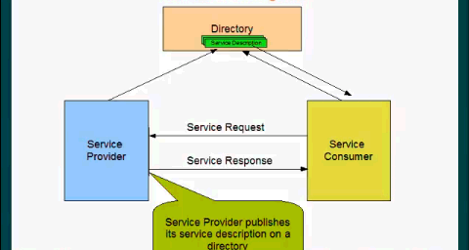
Service Description

Slide 22
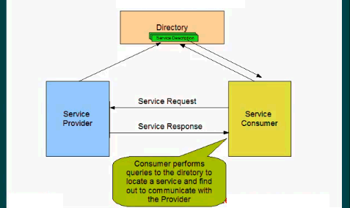
Directory Queries

Slide 23
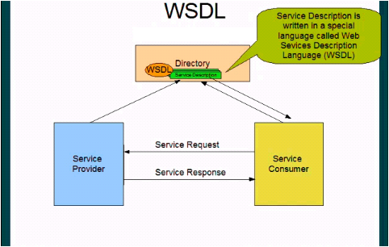
WSDL

Slide 24
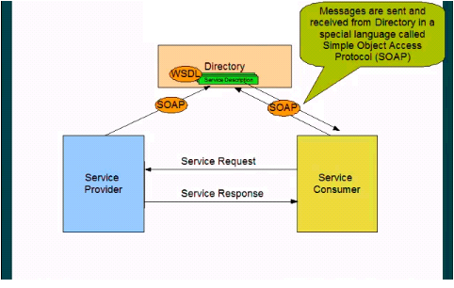
SOAP

Slide 25
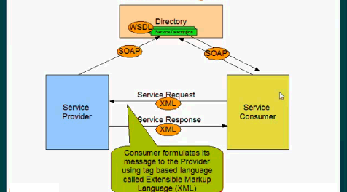
XML Message

Slide 26
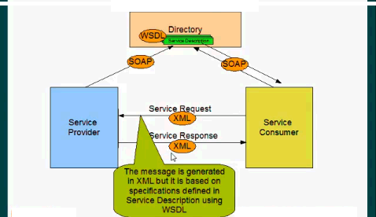
Messaged based on WSDL

Slide 27
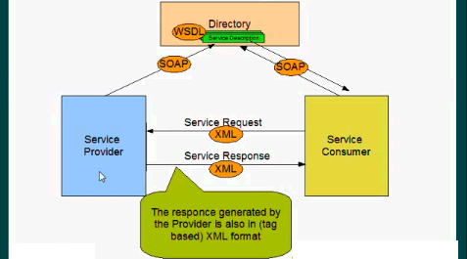
XML Response

Slide 28
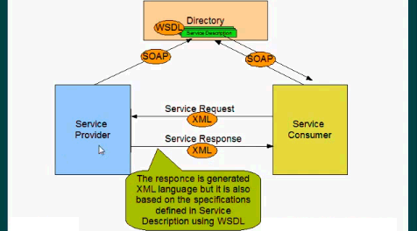
Response based on WSDL

Slide 29
Tenets(Principles) of SOA
There are four principles of SOA
Explicit boundaries
- SOA is about passing message from A to B
crossing explicit and formal boundaries
- Explicit boundaries mean Services can be
deployed anywhere without any specific
platform needs and can be easily a easily
accessible by other services.
- Cost is associated to cross the boundaries
i.e. communication, performance, processing overhead costs

Slide 30
Tenets(Principles) of SOA
Services are autonomous
- Services are built and deployed independently
- Each service must be managed and versioned
quickly.
- It should be replaceable.
- Redudancy should be used in the case of
service failure or not available
- Services are to built not to fail.

Slide 31
Tenets(Principles) of SOA
Policy based compatibility
- Services need to know a little more about each other.
Policies allows to migrate service from one environment to another.
Policy: Explicit Information about service.
For example: Meeting strangers with Resume.
- Each service has its own compatibility level and knows how to communicate with other.
- Services are not knowing each other (stranger).
- If two services cant satisfy each others policy requirements, they will not communicate.

Slide 32
Tenets(Principles) of SOA
Shared Schemas and contracts
- Schemas=data and contracts=behaviour.
- Services do not pass classes, objects or data types
- Services pass schemas and contracts.
- This makes service loosely coupled and 100%
platform independent.

Slide 33
Summary of SOA
Services are platform and location independent. A service does not care where the service is located, and it does not care about the environment of another service.
Services are isolated.
Services communicate via messages.
Service communication information is flexible in terms of protocol, format and transport.
Services are scalable. (Online Payment Example)
Service can be migrated from one environment to another by changing its policy..

Slide 34
Web Service
A web service is a method of communication between two electronic devices over the World Wide Web. A web service is a software function provided at a network address over the web or the cloud, it is a service that is "always on" as in the concept of utility computing.
The W3C defines a "Web service" as:
A software system designed to support interoperable machine-to-machine interaction over a network. It has an interface described in a machine-processable format (specifically WSDL). Other systems interact with the Web service in a manner prescribed by its description using SOAP messages, typically conveyed using HTTP with an XML serialization in conjunction with other Web-related standards.

